Slide 1
Single-trial classification of EEGs during visual and auditory stimulus
Liz Mills, Steven Emmel, Justin Faber, Sydney Feldman
March 11, 2021

Slide 2
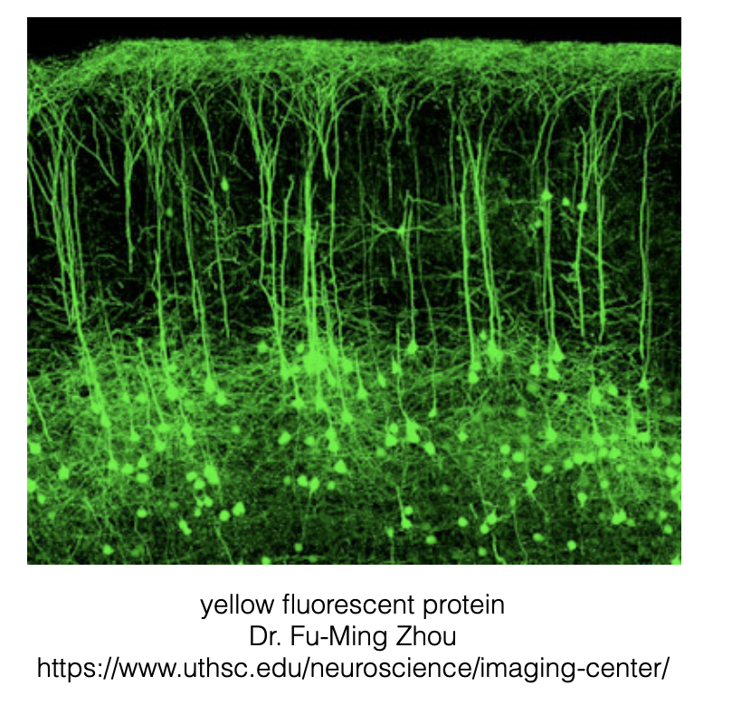
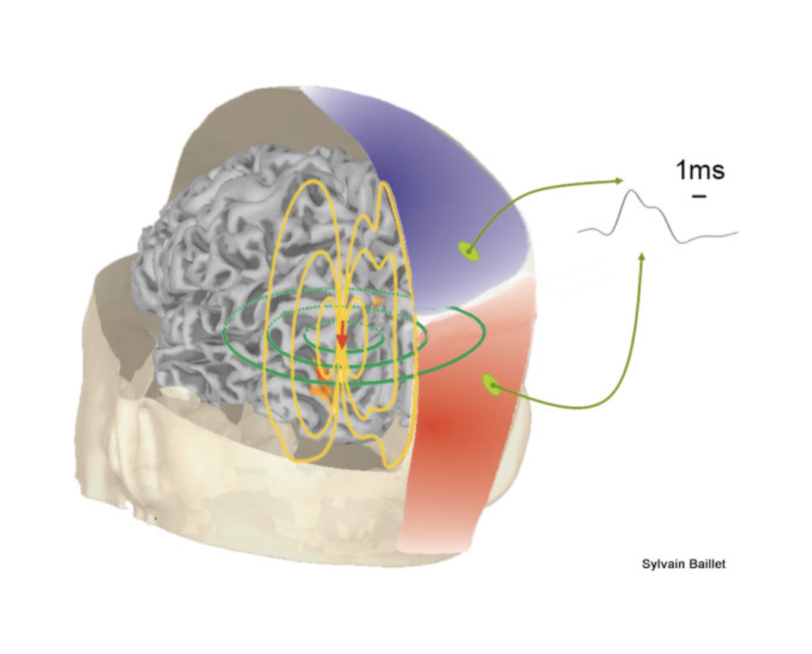
Notes:
Naive Bayes
Random Forest
SVM

Slide 3
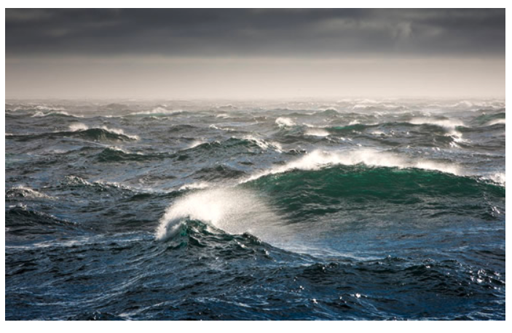
Averaging removes any signal that is NOT perfectly time-locked to trial start
If we AVERAGE many trials, we can reduce increase SNR
But only capture truly time-locked signal
Different tasks can have different time-locked brain response
But averaging can remove some real signal (consider averaging time-points of ocean waves)
NO WAVES (unless perfectly time-locked)
http://passyworldofmathematics.com/mathematics-of-ocean-waves-and-surfing/

Slide 4
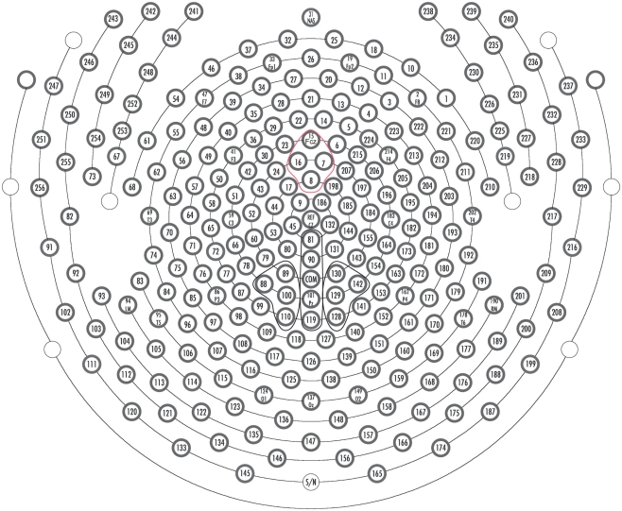
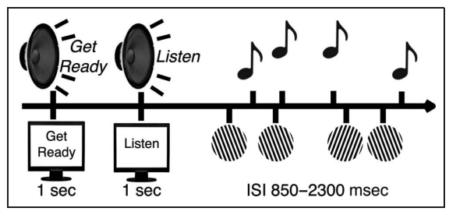
Experimental Methods - Brain voltage
Subject task:
When task was listening, then subject would ignore the objects.
When task was watching, then subject would ignore the sounds.
Lenartowicz et al, J. Cog. Neuro (2014).
Notes:
Publication was focused on differences in AVERAGE brain signal between auditory attending/ignoring/passive and visual attending/ignoring/passive.
The averages were able to show a difference, but we are interested in single trial classification.
This would allow us to categorize the event in real time.
We took a more conservative approach. Instead of doing attending versus ignoring, we looked at distinguishing auditory attending and visual attending.
This was kind of like a proof of concept. -- the data were not heavily pre-processed.
Only filtered at .1 Hz high pass filter (to remove drift in the signal).
There were still muscle/eye/jaw artificats in the signal, and it was not possible to see a difference in single trials by eye.

Slide 5
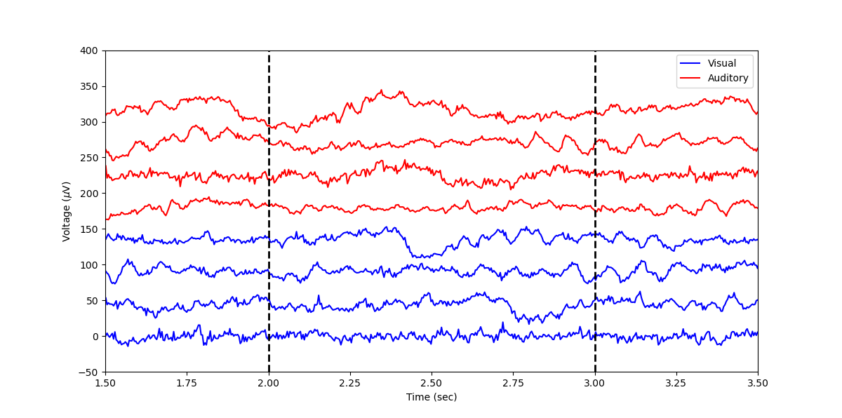
Visualizing the Raw Data
Notes:
Different trials, all from a single channel. Over 500 trials for both auditory and visual stim. NOTE: we took only trials where the subject answered the task question correctly, showing that there was indeed reliable brain signal that was on task. Cognitive performance matched the task. Maybe there are more eyeblinks in the visual processing than in the auditory processing though.
Did throw out bad channels, interpolate, and change voltage to an average reference (just changing the zero potential). If electrodes had full coverage then should be average zero voltage throughout the entire brain, given that sources are dipoles and they have net zero charge.

Slide 6
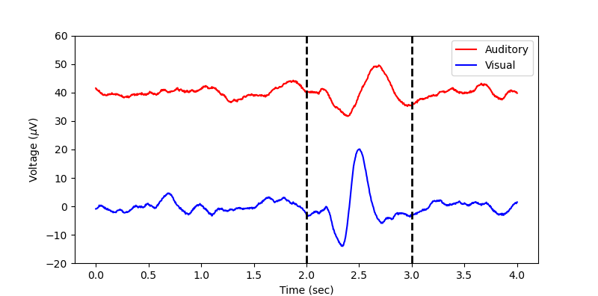
Averaging Over Trials
Notes:
E37 - Frontal electrode

Slide 7
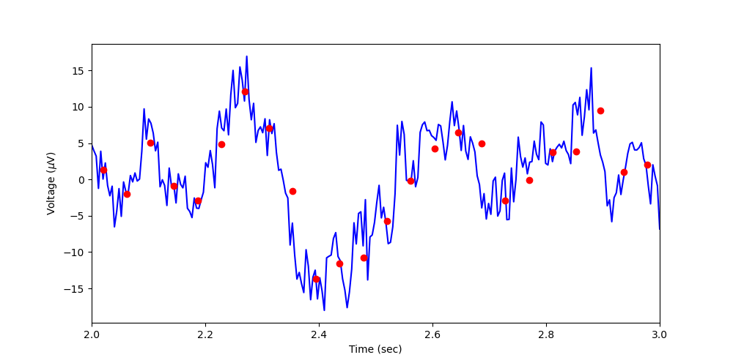
Feature Engineering

Slide 8
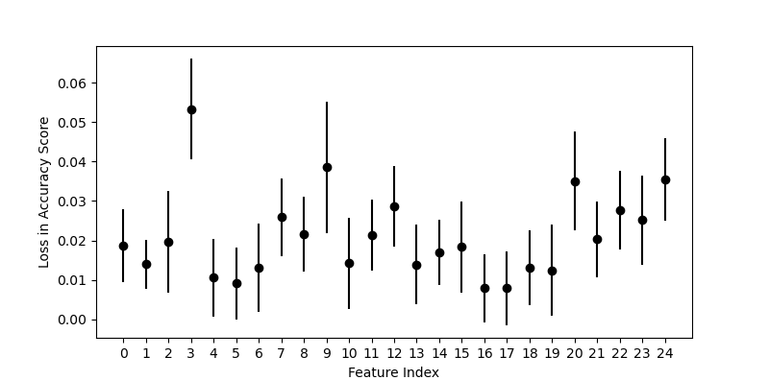
What part of the signal is most important?
Notes:
FEATURE INDES - time

Slide 9
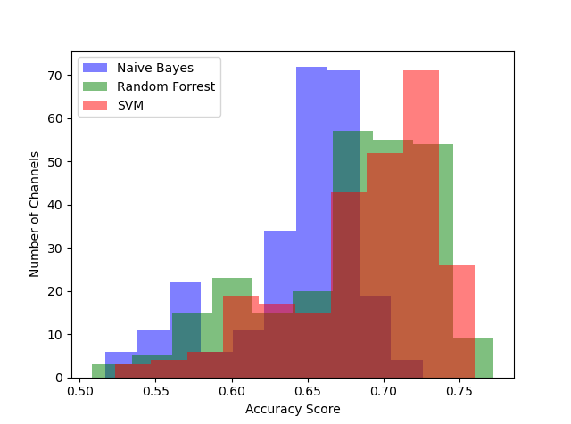
Comparison of several ML models across all 256 Channels
(single-trial single-channel classification)
Support Vector Machines (SVM) have the highest average accuracy score across the channels.
Tuning the hyper parameters of all channels minimally affected the statistics of these distributions.
However, tuning the hyper parameters of the individual channels could be used to improve the accuracy score.
Notes:
STEVE
10 data point windows 250 -> 25

Slide 10
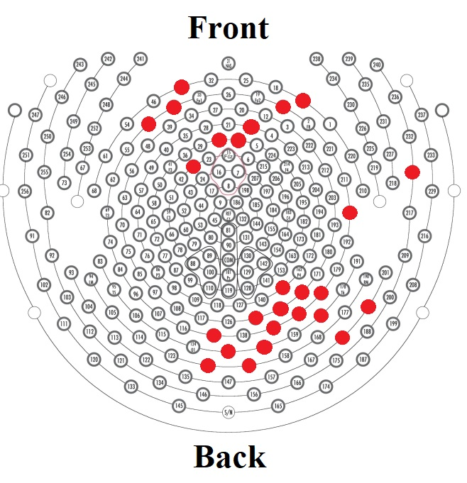
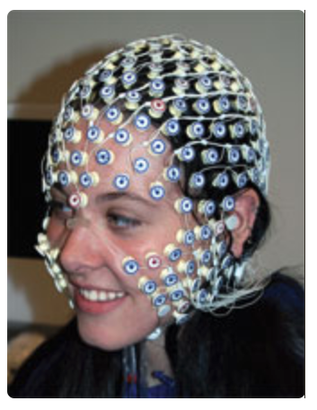
Accuracy score depends on channel location
The most accurate channels ( > 74% accuracy) were located on the front and back of the head.
The front and back of the head are the primary locations for auditory and visual processing, respectively.
Notes:
e137 and e38 give best pair together

Slide 11
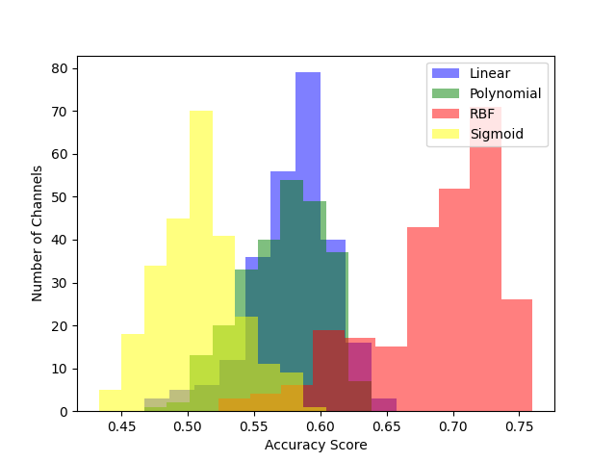
Comparing Kernels in SVM
RBF unsurprisingly performs better than the other kernels
Here the default values of the hyperparameters were taken for each model
Notes:
Interesting paper suggesting future step: linear combination of multiple kernels:
https://www.ncbi.nlm.nih.gov/pmc/articles/PMC4168520/

Slide 12
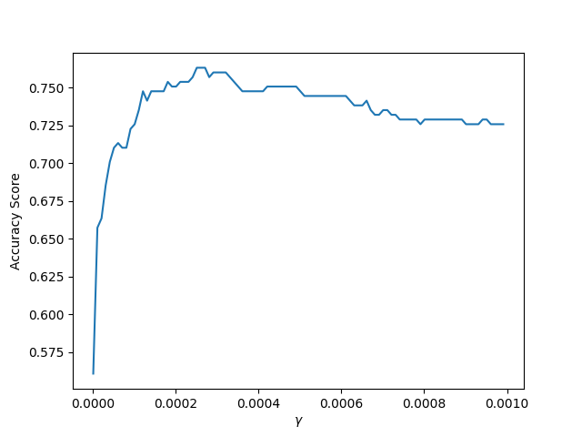
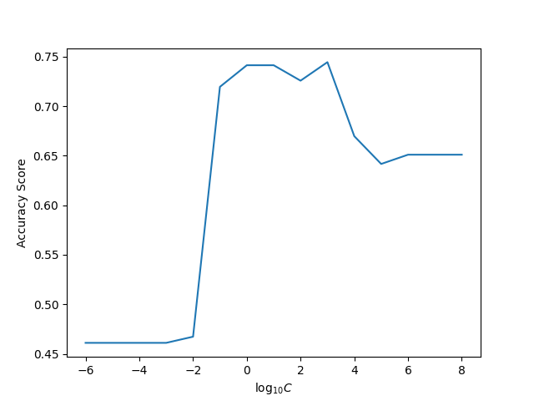
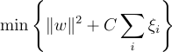
Tuning Hyperparameters

Slide 13
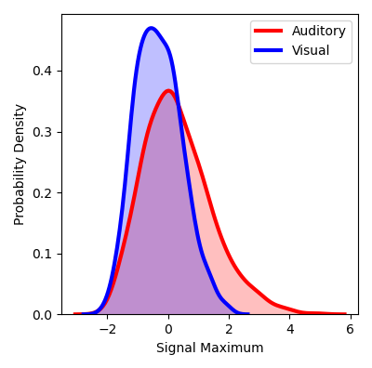
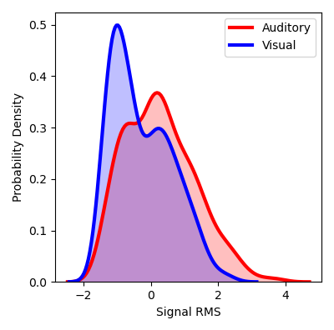
More Feature Engineering (Signal Statistics)

Slide 14
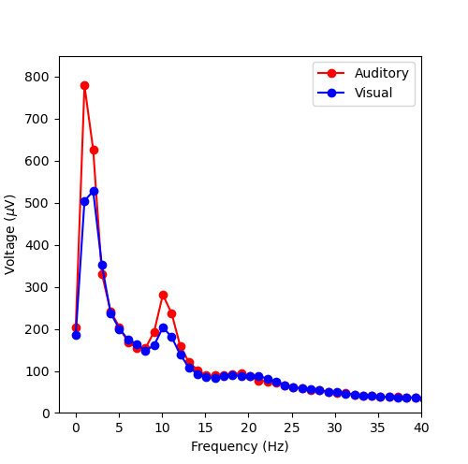
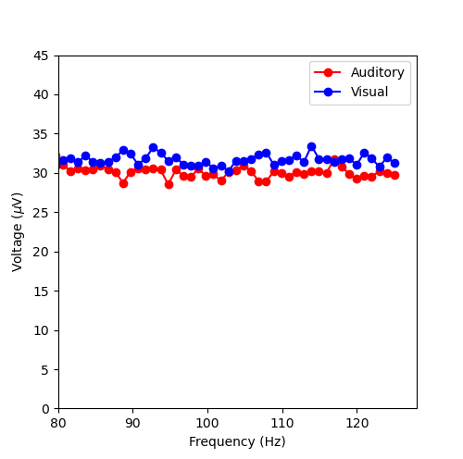
Frequency Domain

Slide 15
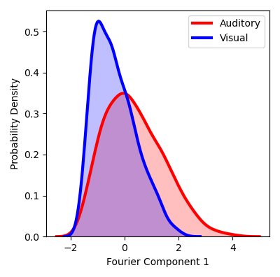
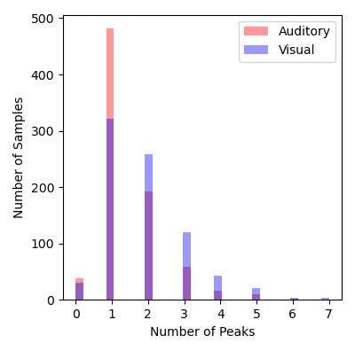
More Feature Engineering (Signal Statistics)

Slide 16
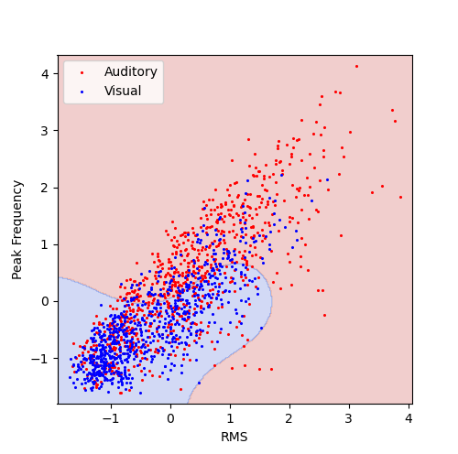
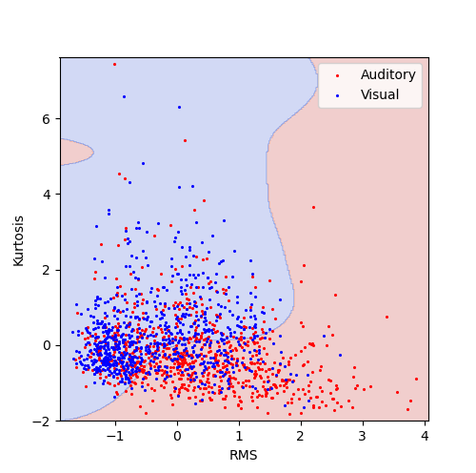
SVM Decision Boundary (Just 2 Features)
Accuracy Score = 0.68
Accuracy Score = 0.65

Slide 17
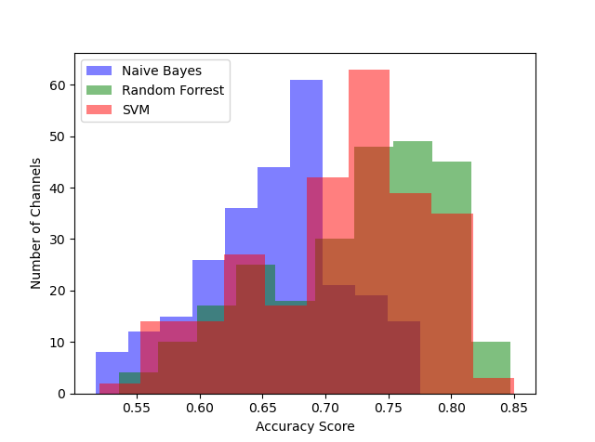
Accuracy Scores over all 256 Channels for an 8-Feature Model
(single-trial single-channel classification)
Features:
3 key Fourier components
Avg. of high frequencies
Signal maximum
RMS
Kurtosis
Number of peaks
SVMs and random forests produced comparable accuracy scores.
All methods produced higher accuracy for the 8-feature model, than the previous model.

Slide 18
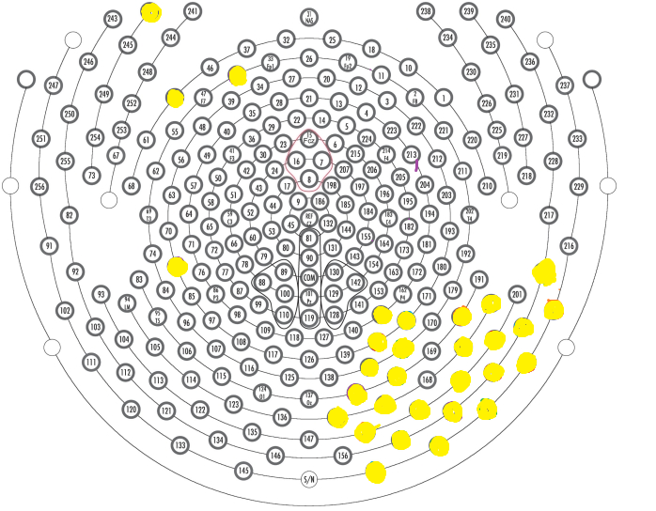
The best accuracy score we could obtain was 90%, using 2 of these highlighted channels (one on the front and one on the back of the head)
Combining the 2 top performing channels overall did not improve the accuracy
Adding a third channel from another location lowered the accuracy score

Slide 19


Slide 20
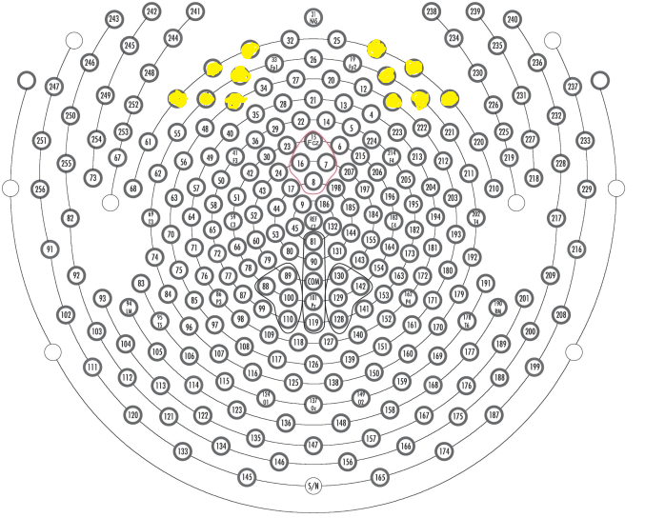

Slide 21
Future Directions?
Questions: other tasks, other intentions,
Diagnoses and states of consciousness?
CAVEATS: eye-blinks/muscle artifacts could be used in addition to brain signal!

